Slide 1
Software processes
Unit 2
Prepared by: Natabar Khatri
New Summit College

Slide 2
Software process
A software process is a set of related activities required to develop high-quality software systems.
organizations tailor their approaches based on factors such as:
Project complexity (small app vs. enterprise system)
Customer needs (fixed requirements vs. evolving demands)
Team expertise (experienced engineers vs. distributed teams)
Regulatory constraints (safety-critical systems vs. consumer apps)
Despite this variability, all effective software processes incorporate the following four core engineering activities:
Software Specification (Requirements Engineering)
Software Development (Design & Implementation)
Software Validation (Testing & Quality Assurance)
Software Evolution (Maintenance & Updates)

Slide 3
Software process
Software Specification (Requirements Engineering)
Defines what the software should do and its operational constraints.
Task involved:
Gathering and analyzing stakeholder needs
Documenting functional & non-functional requirements
Prioritizing features based on business goals
Outputs:
Software Requirements Specification (SRS)
Use case diagrams

Slide 4
Software process
Software Development (Design & Implementation)
Transforms requirements into a working system.
Task involved:
Architectural design (system structure, components)
Detailed design (algorithms, database schemas)
Coding (following best practices like clean code, SOLID principles)
Outputs:
Design documents (UML diagrams, ER models)
Source code
APIs and microservices (if applicable)

Slide 5
Software process
Software Validation (Testing & Quality Assurance)
Purpose: Ensure the software meets specifications and is defect-free.
Key Tasks:
Unit testing (individual components)
Integration testing (interactions between modules)
System & acceptance testing (end-to-end validation)
Outputs:
Test cases and reports
Bug-fix logs
Performance benchmarks

Slide 6
Software process
Software Evolution (Maintenance & Updates)
Purpose: Adapt the software to changing needs over time.
Key Tasks:
Corrective maintenance (fixing defects)
Adaptive maintenance (updating for new environments)
Perfective maintenance (enhancing features)
Outputs: Patches and updates
Versioned releases
Refactored code

Slide 7
Software process Models
Software process models (or SDLC model) provide structured approaches to developing software systems. It is a blueprints that guide teams through the stages of SDLC models.
The general process models that we are going to study:
The Waterfall Model
Incremental Development
Integration & Configuration (Reuse-Oriented Model)
Hybrid Approaches

Slide 8
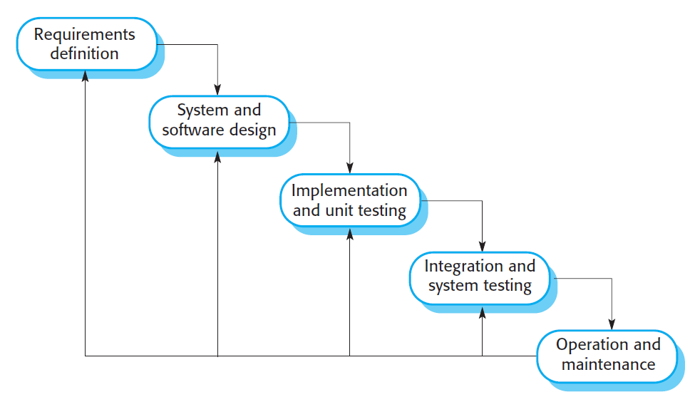
The waterfall model
The Waterfall Model is a linear, sequential approach where each phase must be completed before moving to the next. It aligns closely with the fundamental software engineering activities:
Requirements Definition
System & Software Design
Implementation & Unit Testing
Integration & System Testing
Operation & Maintenance

Slide 9
phases of waterfall model
Requirements analysis and definition:
Objective: Establish system functionalities, constraints, and goals.
Activities:
Gather stakeholder needs through consultations.
Document detailed Software Requirements Specification (SRS).
Output: Approved requirements document.
System and software design:
Objective: Translate requirements into architecture and design.
Activities:
Allocate functions to hardware/software.
Create system architecture diagrams (e.g., UML).
Define data structures, algorithms, and interfaces.
Output: Design specification documents.

Slide 10
phases of waterfall model
Implementation and unit testing:
Objective: Develop and test individual software components.
Activities:
Write code following design specs.
Conduct unit testing (e.g., JUnit for Java).
Output: Functional program units.
Integration and system testing:
Objective: Combine modules and validate the full system.
Activities:
Integrate units into a complete system.
Perform system, performance, and acceptance testing.
Output: Tested, deployable software.

Slide 11
phases of waterfall model
Operation & Maintenance
Objective: Deploy, monitor, and improve the system.
Activities:
Fix bugs (corrective maintenance).
Adapt to new environments (adaptive maintenance).
Add features (perfective maintenance).
Output: Updated software versions.

Slide 12
When to Use Waterfall Model
Projects with stable and well-defined requirements
Low uncertainty (minimal expected changes during development).
Regulated industries (where documentation is mandatory)
In case of Safety-critical systems (e.g., medical devices, avionics) and Large-scale engineering projects (e.g., hardware-software integration).
Notes:
The Waterfall Model remains relevant for high-certainty, regulated, or safety-critical projects where upfront planning is essential. However, its inflexibility makes it unsuitable for modern, fast-paced environments where requirements evolve.

Slide 13
Incremental Development Model
The Incremental Development Model is an iterative approach
software is built in small, functional increments.
Incremental development model is based on the idea of
developing an initial implementation
getting feedback from users and others
and evolving the software through several versions until the required system has been developed
Unlike the rigid Waterfall Model, incremental development interleaves specification, development, and validation in cycles:
Initial Planning
Iterative Development
Develop: Validate: Refine
Final Deployment
Notes:
Each increment or version of the system incorporates some of the functionality
that is needed by the customer. Generally, the early increments of the system
include the most important or most urgently required functionality.

Slide 14
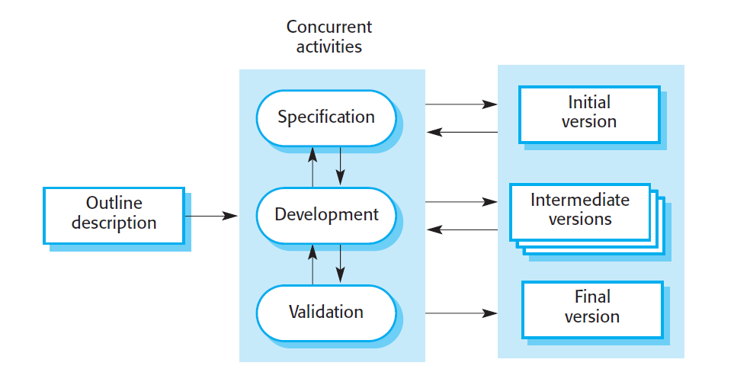
Incremental Development Model

Slide 15
Advantage of Incremental Model
Benefit | Explanation
Lower change costs | Only the current increment needs modification.
Early customer feedback | Users validate working features.
Faster ROI (Return of Inv) | Partial functionality can be deployed early.
Risk mitigation | Issues surface sooner, reducing late-stage failures.

Slide 16
Integration and Configuration
Integration and Configuration is a reuse-driven software development model
leverages off-the-shelf software, libraries, APIs, and services to accelerate development
Key Characteristics
Reuse-Centric
Configurable and
Integration-Focused
Types of Reusable Components
Stand-Alone Application Systems: Example: ERP systems, CMS platforms.
Object Collections & Frameworks: Example: .NET Core
Web Services & APIs: Example: Payment gateways (Stripe, PayPal), Cloud services (AWS S3, Google Maps API)

Slide 17
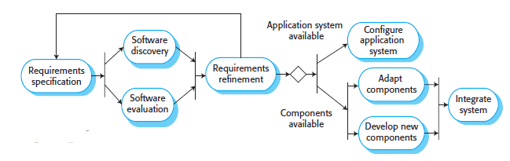
Integration and Configuration
Reuse-oriented software engineering

Slide 18
Integration and Configuration
1. Requirements Specification
Define high-level needs (no deep detail required).
Example: "The system must process payments and manage user profiles."
2. Software Discovery & Evaluation
Search for reusable components (e.g., GitHub, vendor marketplaces).
Evaluate based on:
Compatibility with requirements.
Licensing (open-source vs. proprietary).
Support and scalability.
3. Requirements Refinement
Adjust requirements to align with available components.
Example: If no pre-built fraud detection module exists, modify the system to use a third-party API.

Slide 19
Integration and Configuration
4. Application System Configuration
Customize off-the-shelf (OTS) software (e.g., Shopify for e-commerce).
Example: Configuring WordPress with WooCommerce for an online store.
5. Component Adaptation & Integration
Modify components (if needed) and integrate them.
Example:
Extending an open-source dashboard library (e.g., Grafana) for custom analytics.
Combining Auth0 for login with a custom backend.

Slide 20
Integration and Configuration
When to Use This Model
Enterprise systems (ERP, CRM)
Startups needing rapid MVPs
Cloud-native applications.
Not ideal for:
Highly specialized systems (e.g., spacecraft firmware).
Projects requiring full control over codebase.
Integration and Configuration is a pragmatic approach for modern software engineering, particularly suited for:
Business applications (e.g., SaaS platforms).
Systems with reusable ecosystems (e.g., web/mobile apps).

Slide 21
Process Improvement
Process improvement is a systematic approach to enhancing software development practices to achieve higher product quality, reduced costs and faster delivery times
Two Key Approaches to Process Improvement
Process Maturity Approach
Focus: Enhancing process predictability and product quality through structured management practices
Agile Approach
Focus: Maximizing responsiveness and minimizing overhead

Slide 22
Process Improvement
Process Maturity Approach
Characteristics:
Emphasizes standardization and measurement (e.g., ISO 9001)
Implements proven engineering practices
Uses capability maturity models for assessment (CMMI)
Best suited for large organizations and complex projects
Pros:
Predictability and quality in outcomes
Ideal for large, regulated industries (e.g., aerospace, healthcare).
Cons:
High overhead (documentation, compliance).
Less flexible for dynamic projects

Slide 23
Process Improvement
Agile Approach
Characteristics:
Prioritizes working software over documentation
Emphasizes iterative development
Adapts quickly to changing requirements
Particularly effective for dynamic environments
Pros:
Adapts quickly to changing requirements.
Lowers overhead (focus on working software).
Cons:
Hard to scale for large, complex systems.
Less emphasis on long-term process metrics.

Slide 24
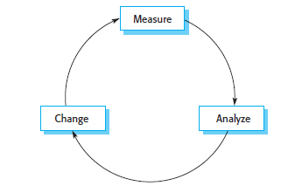
Process Improvement CYCLE
Represents a systematic and structured approach to enhancing software development practices.
The process maturity approach is rooted in plan-driven development and usually requires increased “overhead”.
Agile approaches focus on the code being developed and deliberately minimize formality and documentation.

Slide 25
Process Improvement CYCLE
Process Measurement
The improvement journey begins with quantitative assessment. Organizations must:
Identify key metrics that reflect process effectiveness (e.g., defect rates, cycle time, productivity)
Implement measurement systems to capture these metrics consistently and establish baseline values that represent current performance levels
Process Analysis
With measurement data in hand, teams conduct thorough evaluations to:
Map existing workflows through process modeling techniques
Identify bottlenecks that slow development
Pinpoint quality issues and their root causes
Assess process characteristics like speed, reliability, and adaptability

Slide 26
Process Improvement CYCLE
Process Change
The insights from analysis drive targeted modifications:
Redesigning inefficient workflows
Introducing new quality assurance practices
Removing redundant process steps
Adopting better tools or methodologies
Repeat the cycle to ensure continuous enhancement.

Slide 27
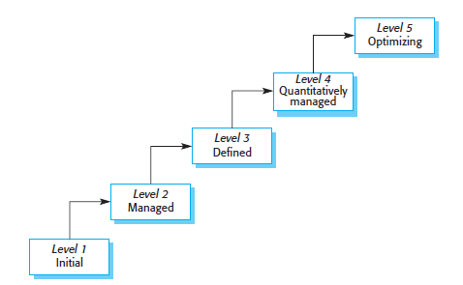
Process Maturity Levels
Originally developed by the Software Engineering Institute (SEI) in the 1980s
Provides a structured framework to assess and improve an organization's software development capabilities
Initially created for the U.S. Department of Defense to evaluate contractors, it has become a global standard for measuring process quality and efficiency.
The Five levels of Process Maturity

Slide 28
Process Maturity Levels
Initial (Level 1)
Characteristics:
Processes are unpredictable and reactive.
Success depends on individual heroics.
No formal documentation or consistency.
Example: A startup coding without requirements or testing protocols.
Managed (Level 2)
Characteristics:
Basic project management is established (schedules, budgets).
Processes are repeatable for similar projects.
Focuses on meeting immediate goals.
Example: A mid-sized company using documented plans but lacking standardization.

Slide 29
Process Maturity Levels
Defined (Level 3)
Characteristics:
Organization-wide standardized processes (e.g., coding standards, QA checklists).
Processes are tailored per project needs.
Knowledge sharing via process assets (templates, guidelines).
Example: A firm with a centralized DevOps pipeline used by all teams.
Quantitatively Managed (Level 4)
Characteristics:
Data-driven decision-making (metrics like defect rates, cycle time).
Statistical process control (SPC) to predict performance.
Subprocesses are measured and optimized.
Example: An enterprise using AI to predict deployment failures based on historical data.

Slide 30
Process Maturity Levels
Optimizing (Level 5)
Characteristics:
Continuous improvement via innovation and feedback loops.
Proactive adaptation to market/technology changes.
Focus on preventing defects (vs. fixing them).
Example: Google’s refined CI/CD pipeline with automated A/B testing.
Understanding these levels, companies can diagnose their current state and plan targeted improvements - whether adopting full CMMI or integrating maturity principles into agile workflows.

